Slide 1
Simple Selector

Slide 2
Agenda
Simple selector
Sample output
Simple selector implementation

Slide 3
Simple selector
We style tags based on selectors.
Example 1:
To style paragraph tag from the html page we use as shown below in internal or external styling.
We will be able to set the same property to all the selectors of p tag this way.
p{
background-color: green;
font-color: blue;
}

Slide 4
Simple selector
Example 2:
If you don’t want to style all the tags, then you can give id to a specific tag you want to style.
#name{
font-size: 14px;
padding: 10px;
}

Slide 5
Simple selector
Example 3:
If you want to style more than one tag irrespective of what tag it is, you can give a class name to all the tags to which you want to apply the same properties.
.dataTable{ // using class selector
border: 2px solid blue;
}

Slide 6
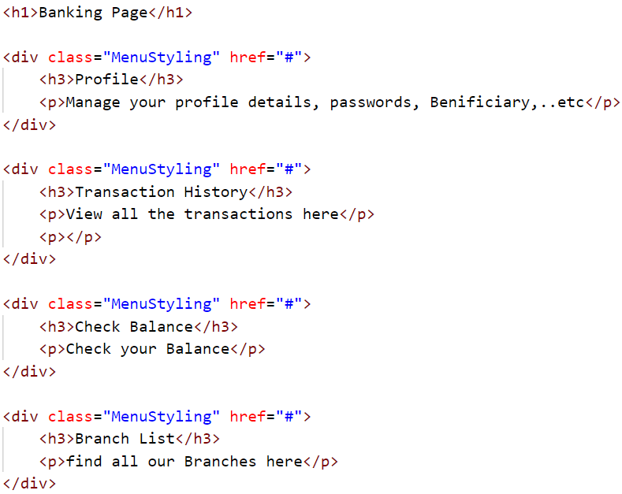
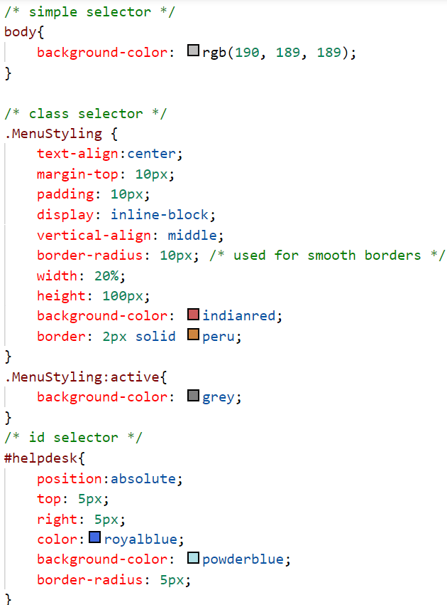
Sample output

Slide 7
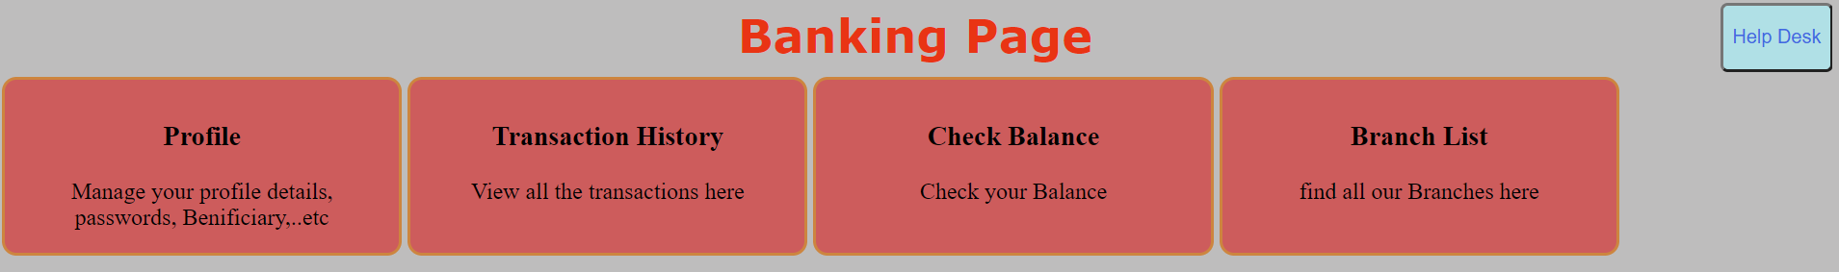
Sample output

Slide 8
Simple selector implementation
Let’s implement the simple selectors.

Slide 9
Summary
We can style elements based on id, name and html tag as selector.
We have seen implementation of the same.
DO NOT WRITE ANYTHING
HERE. LEAVE THIS SPACE FOR
WEBCAM

Slide 10
Thank You
Proprietary content. ©Great Learning. All Rights Reserved. Unauthorized use or distribution prohibited

